Slide 1
Advanced Database
Week 2 – Fundamentals and select command

Slide 2

Database Definition
A collection of organized information so that a computer program can quickly select desired pieces of data (an electronic filing system)
Databases are organized by fields, records, and files.
A field is a single piece of information; a record is one complete set of fields; and a file is a collection of records
To access information from a database, you need a database management system (DBMS) which is a collection of programs that enables you to enter, organize, and select data in a database.

Slide 3
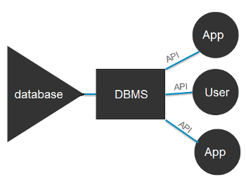
Relational database management system (RDBMS)
A program or suite of programs that lets you create, update, and administer a relational database
Most commercial RDBMS's use the Structured Query Language (SQL) to access the database
The leading RDBMS products are Oracle, IBM's DB2, MySQL and Microsoft's SQL Server.

Slide 4
Relational Databases in Businesses
Businesses generate so much data that it is almost impossible to store everything in flat files (the Boeing 747 has over 1m parts)
Building a RDBMS allows companies to search and find information quickly and efficiently (customers on the phone & website)
With the availability of transactions, businesses can now conduct day to day operations more efficiently (buy, sell, fix, build, etc.)
Large data stores and date warehouses allow storage and retrieval of vast amounts of historical data (legally bound)
Other advantages include, ease of use, flexibility, precision, security and performance (millions of files on one hard-drive)

Slide 5
Table example:
The information inside
the database is organized
into tables.

Slide 6
Data Types – Common Ones
Character – this data type column can hold just about any character that is available on the keyboard, including certain foreign languages
Integer – a value that does not contain a decimal part
Fractional (decimal) – values that do have a decimal part like money values
Date types – will hold any kind of dates but will be localized according to where the application is being ran eg mm/dd/yy versus dd/mm/yy
Booleans – simplest of all types can be a yes or no, 1 or 0, on of off
Click me to show you a complete list of SQL data types
http://www.connectionstrings.com/sql-server-2012-data-types-reference/

Slide 7
The Problem with Null
It is possible for a value to be missing from a record, a situation known as null
Null is not zero
Null is not an empty string
Null is not a value at all
One null value does not equal any other null value
Null simply means that a value is not known
Name | Cost | Quantity | InStock | OrderBy
Hammer | 4.99 | 5 | Yes | 10/10/2016
Nails | 0.25 | 3400 | No | 10/12/2017
Insulation | 12.58 | 1500 | No
Two by Fours | 3.55 | 50 | Yes | 5/8/2016
Click me to show you more information about NULL values.

Slide 8
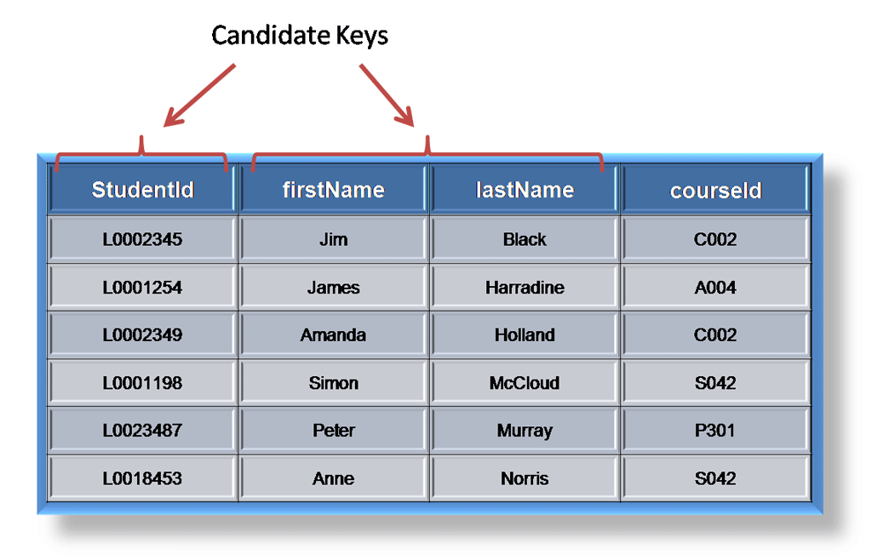
Candidate Keys
Each table must have the ability to identify each record in that table
Usually a Primary Key (PK) will work well
A candidate key is a single field or combination of fields that uniquely identifies each record in the table
It must contain unique values
It must not contain null values
It contains the minimum number of fields to ensure uniqueness
It must uniquely identify each record in the table
Click please
http://rdbms.opengrass.net/2_Database%20Design/2.1_TermsOfReference/2.1.2_Keys.html

Slide 9
Candidate Keys -> Primary Keys
A primary key is a candidate key that will identify each record individually
The PK must contain unique values, must never be null and uniquely identify each record in the table
Primary keys are mandatory for every table. Always choose a single simple key over a composite key
PartNumber | Name | Cost | Quantity | InStock | OrderBy
10025 | Hammer | 4.99 | 5 | Yes | 10/10/2016
10034 | Nails | 0.25 | 3400 | No | 10/12/2017
20058 | Insulation | 12.58 | 1500 | No | 5/6/2015
20057 | Two by Fours | 3.55 | 50 | Yes | 5/8/2016
Can you create a table without a primary key?

Slide 10
Foreign Keys
A foreign key (FK) is usually a primary key from one table that appears as a field in another table, this is where the relational part comes in.
If we had a table A with a primary key X, and that table was related to table B, and B has a field containing X, then X would be a foreign key in B.

Slide 11
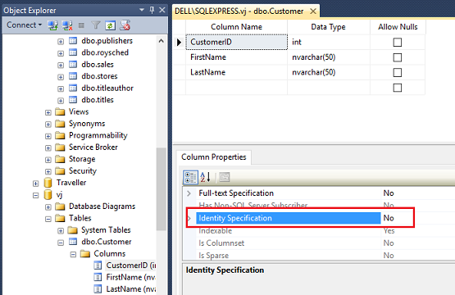
Surrogate vs Natural Keys
A natural key is one that is used in life, such as your SIN & ISBN
A surrogate key is an artificially produced value usually a system-managed, incrementing counter whose values can range from 1 to n, where n represents a table's maximum number of rows

Slide 12
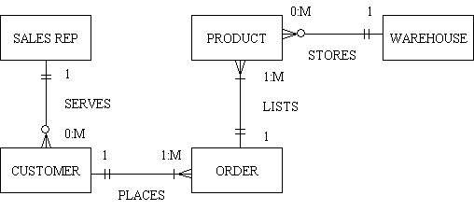
Cardinality
This is a concept that reflects real life as in an Instructor teaches several courses, a doctor has many patients, a bus transports many passengers
Note that in a many-to-many relationship, a problem arises, we will deal with the solution in Appendix B

Slide 13
Domain, Entity & Relational Integrity
A domain relates to all the possible values that a field can have
A house_number field may have 1-99999 and no other numbers
An entity is an object in the real world
Usually nouns like Instructor, Course, Student
Relational integrity means that if a parent table has a record and the child table is deleted, the parent may be affected
An Instructor may teach a course, if that course is deleted, it will create a problem in the Instructor table, missing course!

Slide 14
Automatic Data Backup
Management Studio allows you to back up a database. Then, if you accidentally modify or delete data, you can easily restore it.
After installing the SSMS, try to find how to manage it.

Slide 15
Appendix A - Integrity
Orders Table
Customers Table
Order_Number | Customer_Number | Product_Number
560121 | 100 | 526
City Table
Customer Number | First Name | Last Name | City_Code
100 | John | Doe | 25
City_Code | City
24 | Kitchener
25 | Waterloo
John Doe who lives in Waterloo bought product number 526 and his order number was 560121

Slide 16
Appendix B – M2M
ProductNo | Name | Cost | Quantity | InStock
100 | Hammer | 4.99 | 5 | Yes
102 | Nails | 0.25 | 3400 | No
104 | Insulation | 12.58 | 1500 | No
105 | Two by Fours | 3.55 | 50 | Yes
CustomerName | ProductNo | Quantity | OrderedOn
Tom | 105 | 6 | 5/9/2016
Sally | 104 | 4 | 5/2/2017
Pablo | 104 | 23 | 6/12/2014
Saith | 100 | 4 | 10/6/2016
Notes:
On the left is the products table and customers on the right, the problem is what if tom wanted to purchase other items

Slide 17
Appendix B – M2M
ProductNo | Name | Cost | Quantity | InStock
100 | Hammer | 4.99 | 5 | Yes
102 | Nails | 0.25 | 3400 | No
104 | Insulation | 12.58 | 1500 | No
105 | Two by Fours | 3.55 | 50 | Yes
CustomerNo | ProductNo | Quantity | OrderedOn
Tom | 105 | 6 | 5/9/2016
Sally | 104 | 4 | 5/2/2017
Pablo | 104 | 23 | 6/12/2014
Saith | 100 | 4 | 10/6/2016
CustomerName | ProductNo | Quantity | OrderedOn
Tom | 105 | 6 | 5/9/2016
Sally | 104 | 4 | 5/2/2017
Pablo | 104 | 23 | 6/12/2014
Saith | 100 | 4 | 10/6/2016
Tom | 104 | 6 | 5/5/2016
Tom | 100 | 6 | 5/10/2016
Notes:
The problem created is repeating rows, which is a bad idea in db design

Slide 18
Appendix B – M2M
ProductNo | Name | Cost | Quantity | InStock
100 | Hammer | 4.99 | 5 | Yes
102 | Nails | 0.25 | 3400 | No
104 | Insulation | 12.58 | 1500 | No
105 | Two by Fours | 3.55 | 50 | Yes
CustomerName | ProductNo | Quantity | OrderedOn
Tom | 105 | 6 | 5/9/2016
Sally | 104 | 4 | 5/2/2017
Pablo | 104 | 23 | 6/12/2014
Saith | 100 | 4 | 10/6/2016
Tom | 104 | 6 | 5/5/2016
Tom | 100 | 6 | 5/10/2016
CustomerNo | ProductNo | PurchaseDate
1001 | 105
1001 | 104
1001 | 100
1005 | 104
1005 | 100
1008 | 100
1009 | 105
Notes:
To solve the problem create a go-between, a table that simply lists the customers who purchased products
In the example Tom (whose id is 1001) purchased 3 different types of products, Sally (1005) purchased 2 different types of products etc.

Slide 19
Appendix – Miscellaneous Topics
Know and understand how memory works
Large databases are difficult to work with so we create smaller sub-sets of them and keep them in memory for faster performance
Logical operators like = <> >=<= etc.
This knowledge comes in hand when you want to retrieve a particular set of records
The concept of wildcard characters especially %, _ and of course the asterisk *
These make life easier when trying to remember certain datum

